Slide 1

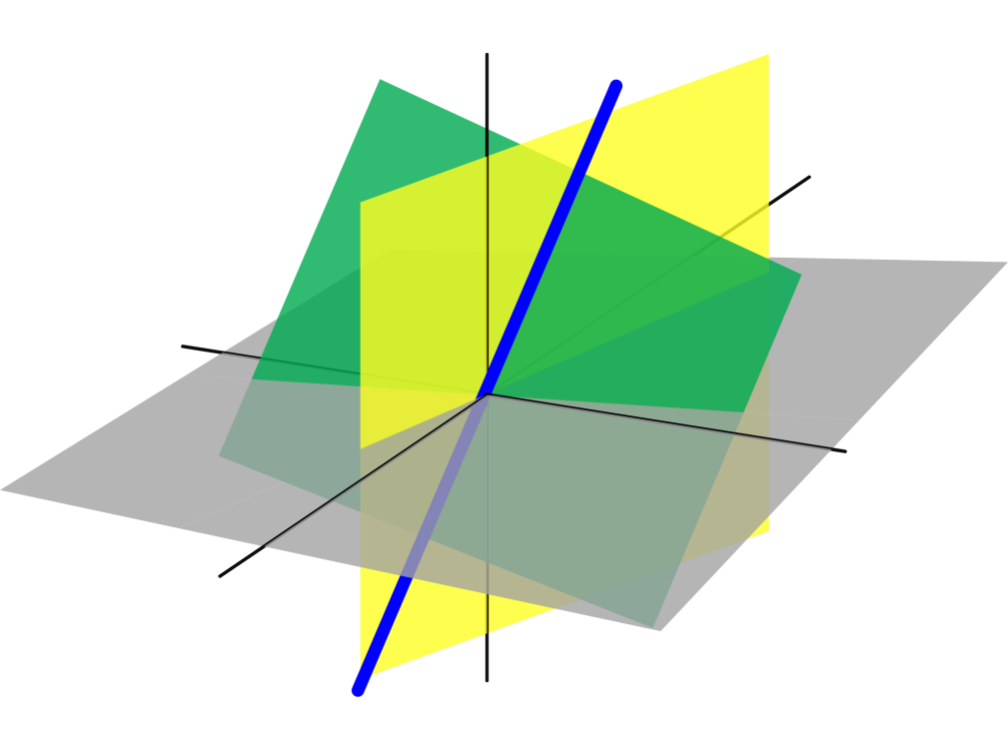
Azərbaycan Dövlət Neft və Sənaye Universiteti
Linear Algebra

Slide 2
There are some similarities between the algebra of real numbers and the algebra of matrices.
This lecture further develops the algebra of matrices to include the solutions of matrix equations involving matrix multiplication.
Inverse of a Matrix

Slide 3
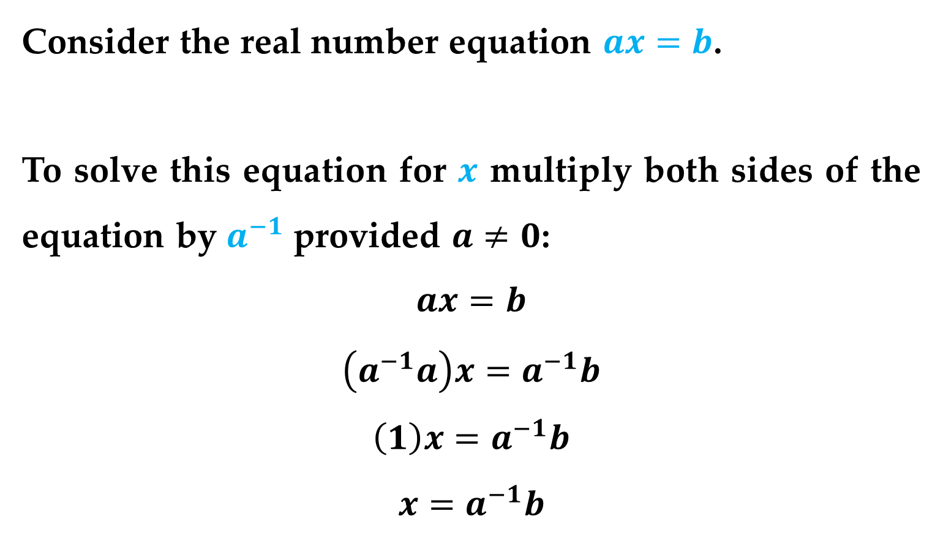
Example
Consider the real number equation $ax=b$.
To solve this equation for $x$ multiply both sides of the equation by $a^{−1}$ provided $a≠0$:
$$ax=b$$
$$\left(a^{−1}a\right)x=a^{−1}b$$
$$\left(1\right)x=a^{−1}b$$
$$x=a^{−1}b$$
The Inverse of a Matrix

Slide 4
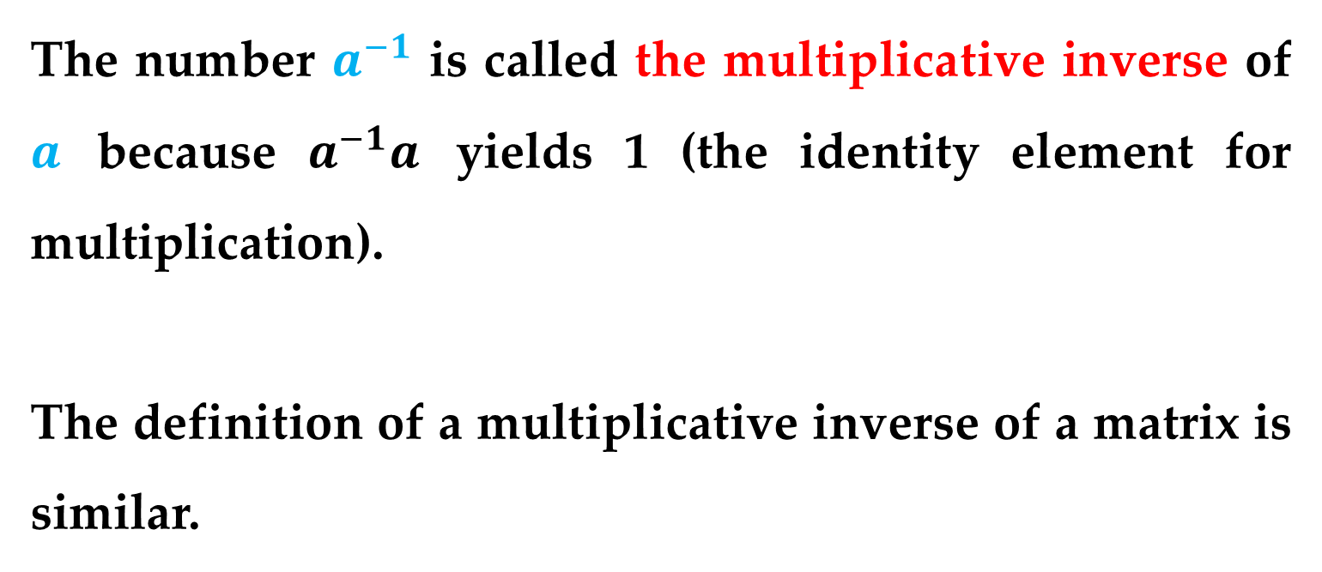
The number $a^{−1}$ is called the multiplicative inverse of $a$ because $a^{−1}a$ yields 1 (the identity element for multiplication).
The definition of a multiplicative inverse of a matrix is similar.
The Inverse of a Matrix

Slide 5
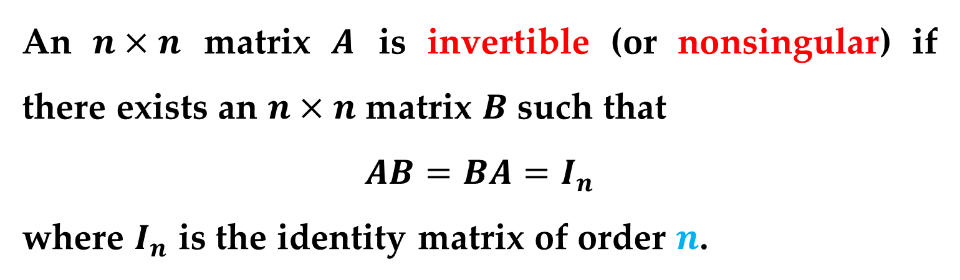
Definition (Inverse of a Matrix)
An $n×n$ matrix $A$ is invertible (or nonsingular) if there exists an $n×n$ matrix $B$ such that
$$AB=BA=I_{n}$$
where $I_{n}$ is the identity matrix of order $n$.
The matrix $B$ is called the multiplicative inverse of $A$.
A matrix that does not have an inverse is called noninvertible (or singular).
Non-square matrices do not have inverses.
The Inverse of a Matrix

Slide 6
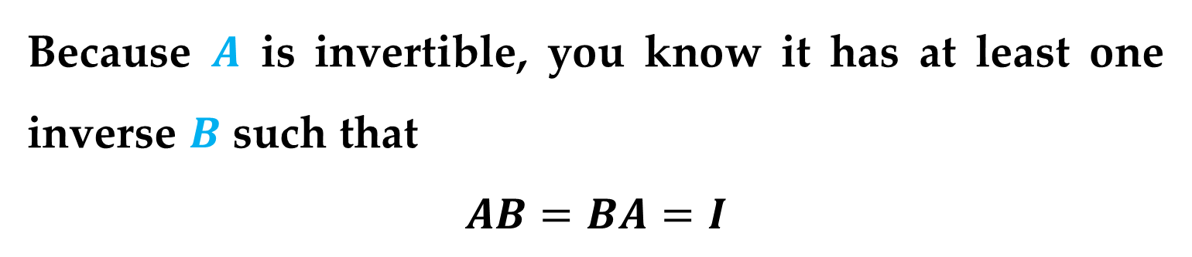
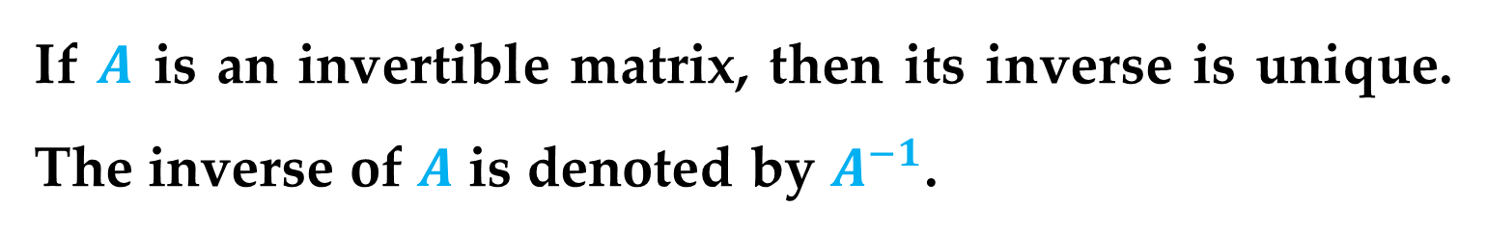

Theorem (Uniqueness of an Inverse Matrix)
If $A$ is an invertible matrix, then its inverse is unique. The inverse of $A$ is denoted by $A^{−1}$.
Proof
Because $A$ is invertible, you know it has at least one inverse $B$ such that
$$AB=BA=I$$
Suppose $A$ has another inverse $C$ such that
$$AC=CA=I$$
The Inverse of a Matrix

Slide 7
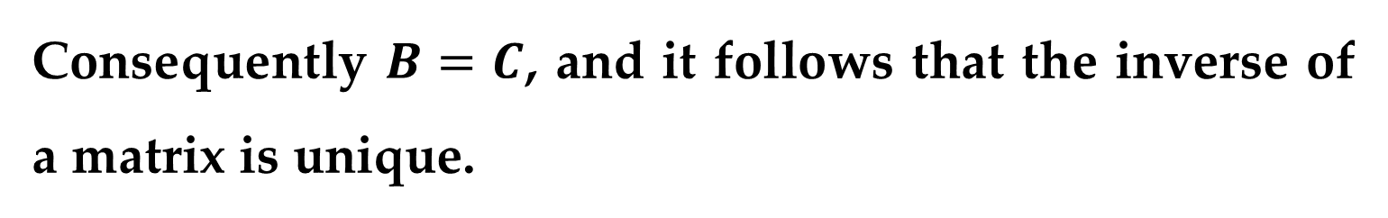
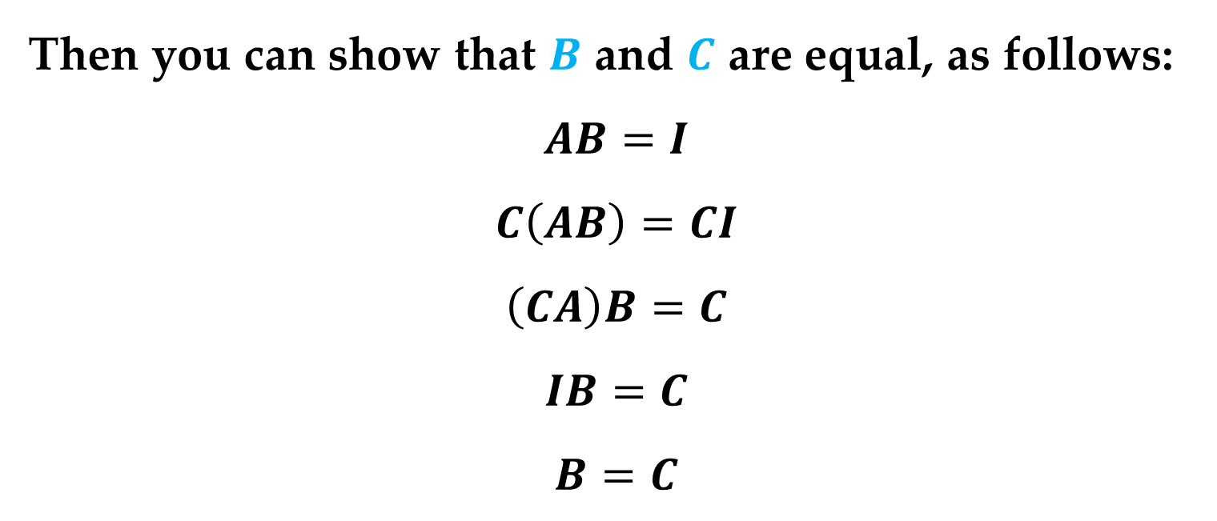
Proof (continued)
Then you can show that $B$ and $C$ are equal, as follows:
$$AB=I$$
$$C\left(AB\right)=CI$$
$$\left(CA\right)B=C$$
$$IB=C$$
$$B=C$$
Consequently $B=C$, and it follows that the inverse of a matrix is unique.
The Inverse of a Matrix

Slide 8

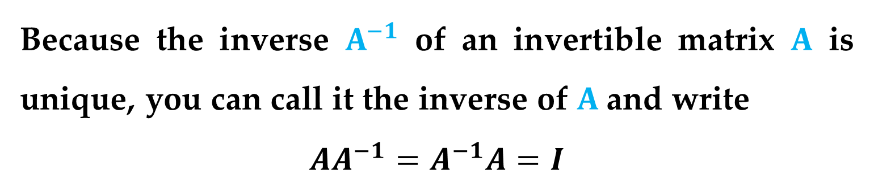
Because the inverse $A^{−1}$ of an invertible matrix $A$ is unique, you can call it the inverse of $A$and write
$$AA^{−1}=A^{−1}A=I$$
Example 1. The Inverse of a Matrix
Show that $B$ is the inverse of $A$ where
$$A=\left[\begin{matrix}−1 & 2 \\ −1 & 1\end{matrix}\right] and B=\left[\begin{matrix}1 & −2 \\ 1 & −1\end{matrix}\right]$$
The Inverse of a Matrix

Slide 9
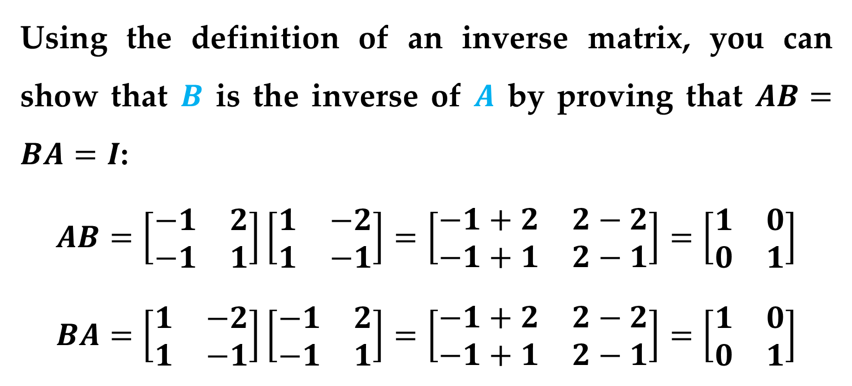
Solution
Using the definition of an inverse matrix, you can show that $B$ is the inverse of $A$ by proving that $AB=BA=I$:
$$AB=\left[\begin{matrix}−1 & 2 \\ −1 & 1\end{matrix}\right]\left[\begin{matrix}1 & −2 \\ 1 & −1\end{matrix}\right]=\left[\begin{matrix}−1+2 & 2−2 \\ −1+1 & 2−1\end{matrix}\right]=\left[\begin{matrix}1 & 0 \\ 0 & 1\end{matrix}\right]$$
$$BA=\left[\begin{matrix}1 & −2 \\ 1 & −1\end{matrix}\right]\left[\begin{matrix}−1 & 2 \\ −1 & 1\end{matrix}\right]=\left[\begin{matrix}−1+2 & 2−2 \\ −1+1 & 2−1\end{matrix}\right]=\left[\begin{matrix}1 & 0 \\ 0 & 1\end{matrix}\right]$$
The Inverse of a Matrix

Slide 10
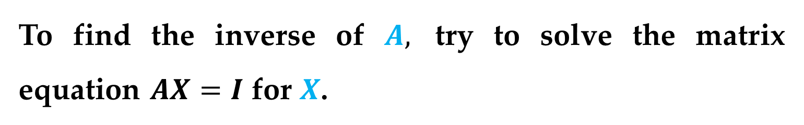

The next example shows how to use a system of equations to find the inverse of a matrix.
Example 2. Finding the Inverse of a Matrix
Find the inverse of the matrix
$$A=\left[\begin{matrix}1 & 4 \\ −1 & −3\end{matrix}\right]$$
Solution
To find the inverse of $A,$ try to solve the matrix equation $AX=I$ for $X$.
The Inverse of a Matrix

Slide 11

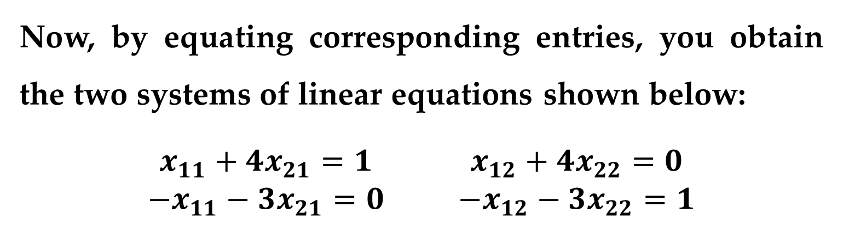
Solution (continued)
$$\left[\begin{matrix}1 & 4 \\ −1 & −3\end{matrix}\right]\left[\begin{matrix}x_{11} & x_{12} \\ x_{21} & x_{22}\end{matrix}\right]=\left[\begin{matrix}1 & 0 \\ 0 & 1\end{matrix}\right]$$
$$\left[\begin{matrix}x_{11}+4x_{21} & x_{12}+4x_{22} \\ −x_{11}−3x_{21} & −x_{12}−3x_{22}\end{matrix}\right]=\left[\begin{matrix}1 & 0 \\ 0 & 1\end{matrix}\right]$$
Now, by equating corresponding entries, you obtain the two systems of linear equations shown below:
$$\begin{matrix}\begin{matrix}x_{11}+4x_{21}=1 \\ −x_{11}−3x_{21}=0\end{matrix} & \begin{matrix}x_{12}+4x_{22}=0 \\ −x_{12}−3x_{22}=1\end{matrix}\end{matrix}$$
The Inverse of a Matrix

Slide 12
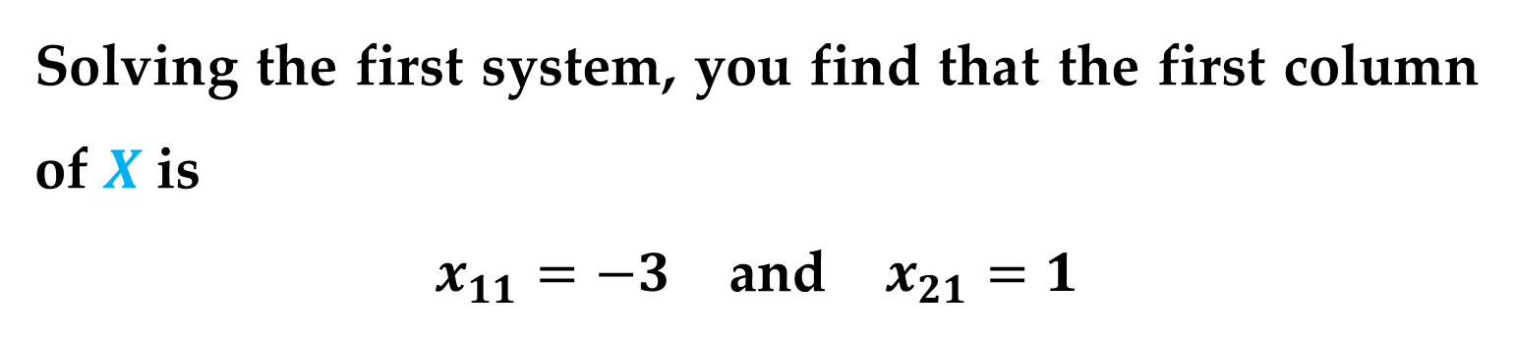

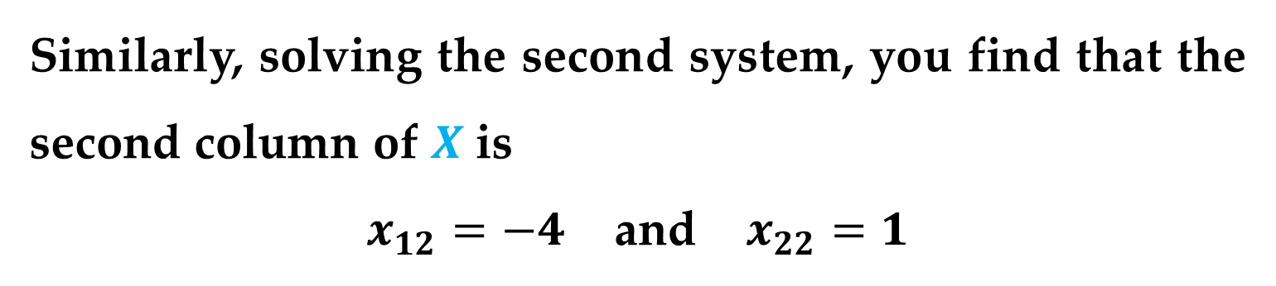
Solution (continued)
Solving the first system, you find that the first column of $X$ is
$x_{11}=−3$ and $x_{21}=1$
Similarly, solving the second system, you find that the second column of $X$ is
$x_{12}=−4$ and $x_{22}=1$
Therefore the inverse of $A$ is
$$X=A^{−1}=\left[\begin{matrix}−3 & −4 \\ 1 & 1\end{matrix}\right]$$
The Inverse of a Matrix

Slide 13
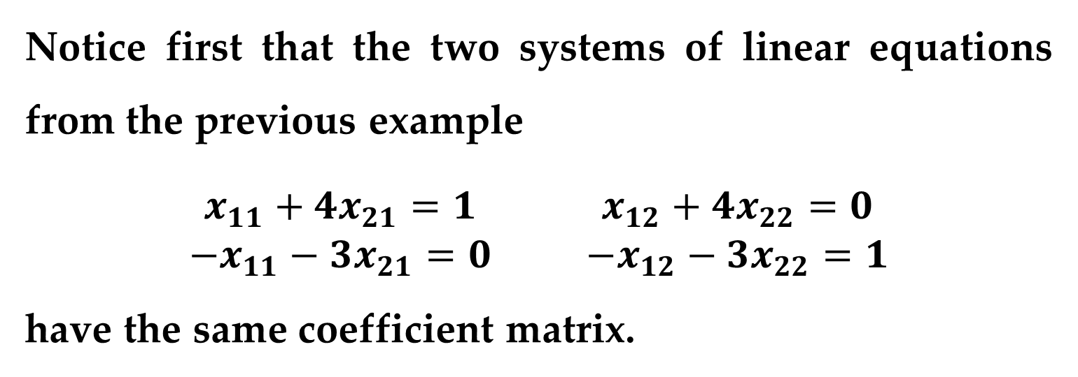
Remark
Notice first that the two systems of linear equations from the previous example
$$\begin{matrix}\begin{matrix}x_{11}+4x_{21}=1 \\ −x_{11}−3x_{21}=0\end{matrix} & \begin{matrix}x_{12}+4x_{22}=0 \\ −x_{12}−3x_{22}=1\end{matrix}\end{matrix}$$
have the same coefficient matrix.
The Inverse of a Matrix

Slide 14
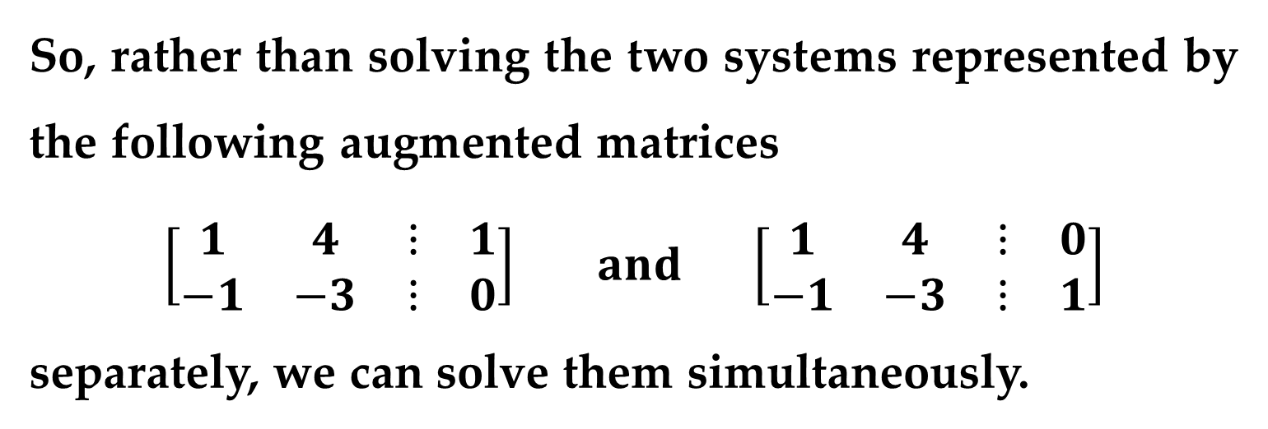
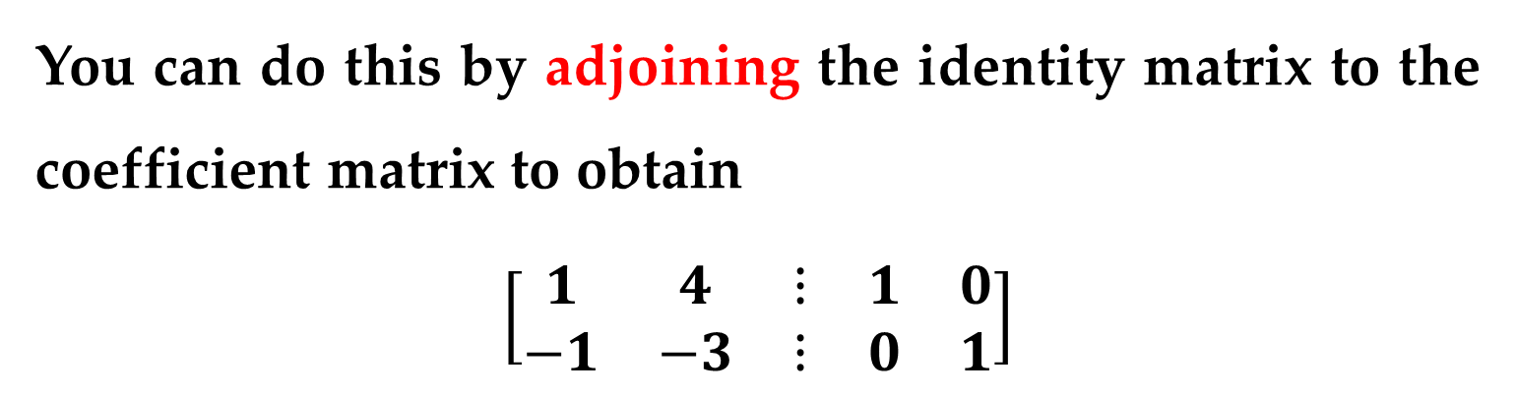
So, rather than solving the two systems represented by the following augmented matrices
$$\left[\begin{matrix}\begin{matrix}1 & 4 \\ −1 & −3\end{matrix} & \begin{matrix}⋮ & 1 \\ ⋮ & 0\end{matrix}\end{matrix}\right] and \left[\begin{matrix}\begin{matrix}1 & 4 \\ −1 & −3\end{matrix} & \begin{matrix}⋮ & 0 \\ ⋮ & 1\end{matrix}\end{matrix}\right]$$
separately, we can solve them simultaneously.
You can do this by adjoining the identity matrix to the coefficient matrix to obtain
$$\left[\begin{matrix}\begin{matrix}1 & 4 \\ −1 & −3\end{matrix} & \begin{matrix}⋮ & 1 & 0 \\ ⋮ & 0 & 1\end{matrix}\end{matrix}\right]$$
The Inverse of a Matrix

Slide 15

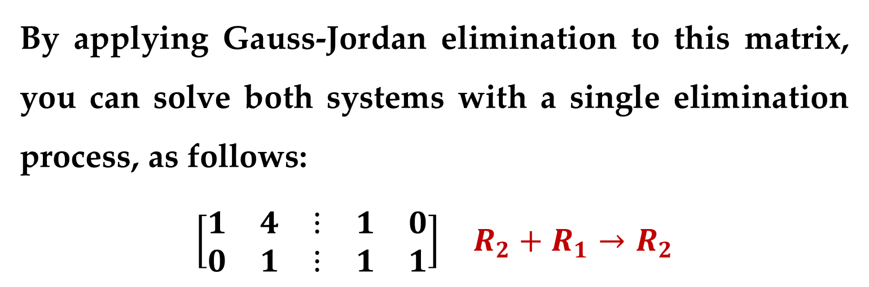
By applying Gauss-Jordan elimination to this matrix, you can solve both systems with a single elimination process, as follows:
$$\begin{matrix}\left[\begin{matrix}\begin{matrix}1 & 4 \\ 0 & 1\end{matrix} & \begin{matrix}⋮ & 1 & 0 \\ ⋮ & 1 & 1\end{matrix}\end{matrix}\right] & R_{2}+R_{1}→R_{2}\end{matrix}$$
$$\begin{matrix}\left[\begin{matrix}\begin{matrix}1 & 0 \\ 0 & 1\end{matrix} & \begin{matrix}⋮ & −3 & −4 \\ ⋮ & 1 & 1\end{matrix}\end{matrix}\right] & R_{1}+(−4)R_{2}→R_{1}\end{matrix}$$
The Inverse of a Matrix

Slide 16
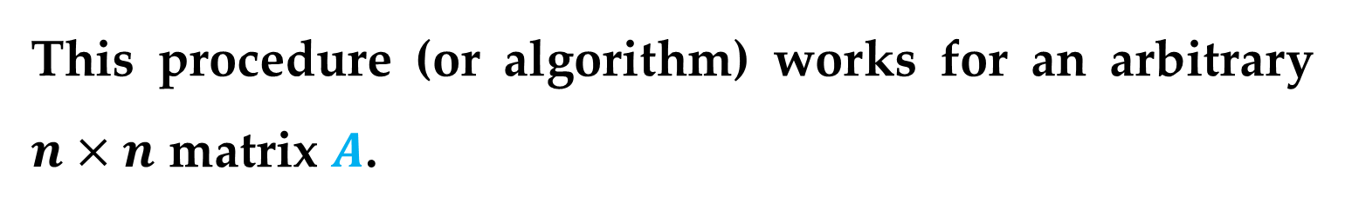
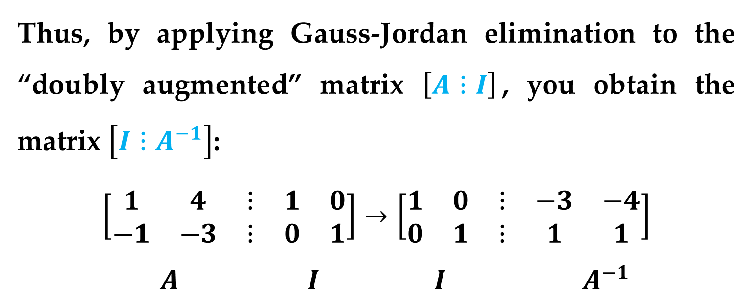
Corollary
Thus, by applying Gauss-Jordan elimination to the “doubly augmented” matrix $\left[A⋮I\right]$, you obtain the matrix $\left[I⋮A^{−1}\right]$:
$$\left[\begin{matrix}\begin{matrix}1 & 4 \\ −1 & −3\end{matrix} & \begin{matrix}⋮ & 1 & 0 \\ ⋮ & 0 & 1\end{matrix}\end{matrix}\right]→\left[\begin{matrix}\begin{matrix}1 & 0 \\ 0 & 1\end{matrix} & \begin{matrix}⋮ & −3 & −4 \\ ⋮ & 1 & 1\end{matrix}\end{matrix}\right]$$
$A$ $I$ $I$ $A^{−1}$
This procedure (or algorithm) works for an arbitrary $n×n$ matrix $A$.
The Inverse of a Matrix

Slide 17
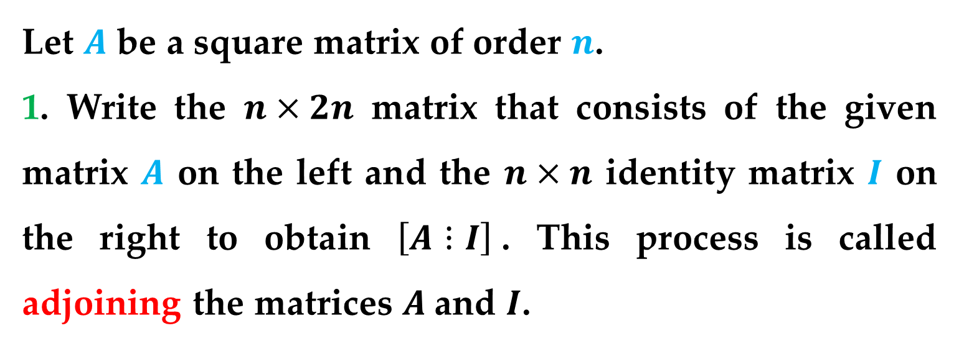
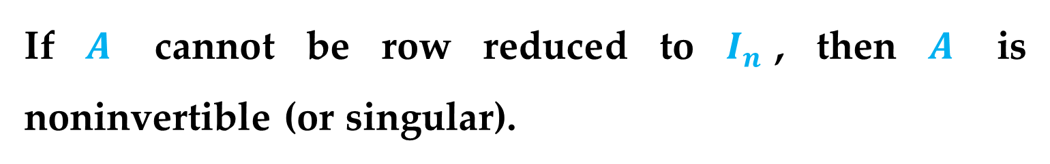
If $A$ cannot be row reduced to $I_{n}$, then $A$ is noninvertible (or singular).
Algorithm (Finding the Inverse of a Matrix by Gauss-Jordan Elimination)
Let $A$ be a square matrix of order $n$.
1. Write the $n×2n$ matrix that consists of the given matrix $A$ on the left and the $n×n$ identity matrix $I$ on the right to obtain $\left[A⋮I\right]$. This process is called adjoining the matrices $A$and $I$.
The Inverse of a Matrix

Slide 18
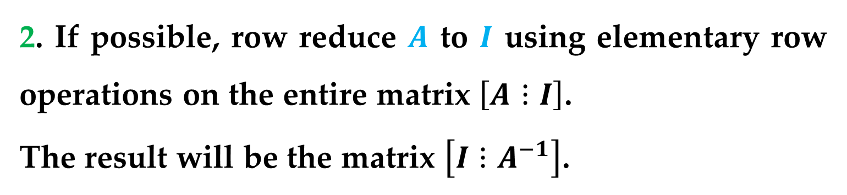
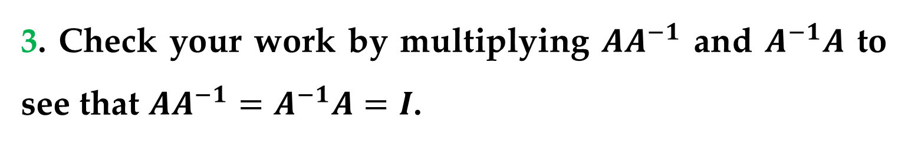
Algorithm (Finding the Inverse of a Matrix by Gauss-Jordan Elimination)
2. If possible, row reduce $A$ to $I$ using elementary row operations on the entire matrix $\left[A⋮I\right]$.
The result will be the matrix $\left[I⋮A^{−1}\right]$.
3. Check your work by multiplying $AA^{−1}$ and $A^{−1}A$ to see that $AA^{−1}=A^{−1}A=I$.
The Inverse of a Matrix

Slide 19

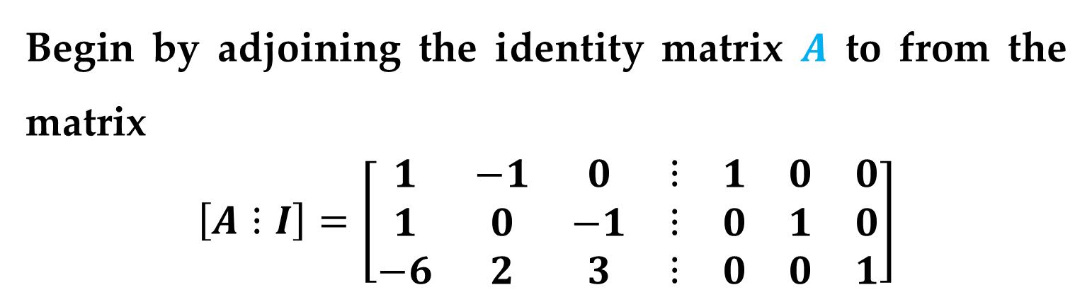
Example 3. Finding the Inverse of a Matrix
Find the inverse of the matrix
$$A=\left[\begin{matrix}1 & −1 & 0 \\ 1 & 0 & −1 \\ −6 & 2 & 3\end{matrix}\right]$$
Solution
Begin by adjoining the identity matrix $A$ to from the matrix
$$\left[A⋮I\right]=\left[\begin{matrix}\begin{matrix}1 & −1 & 0 \\ 1 & 0 & −1 \\ −6 & 2 & 3\end{matrix} & \begin{matrix}⋮ \\ ⋮ \\ ⋮\end{matrix} & \begin{matrix}1 & 0 & 0 \\ 0 & 1 & 0 \\ 0 & 0 & 1\end{matrix}\end{matrix}\right]$$
The Inverse of a Matrix

Slide 20
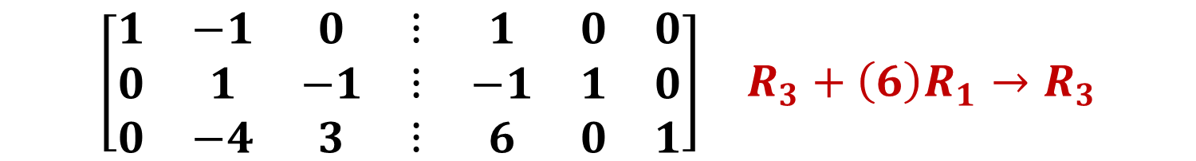
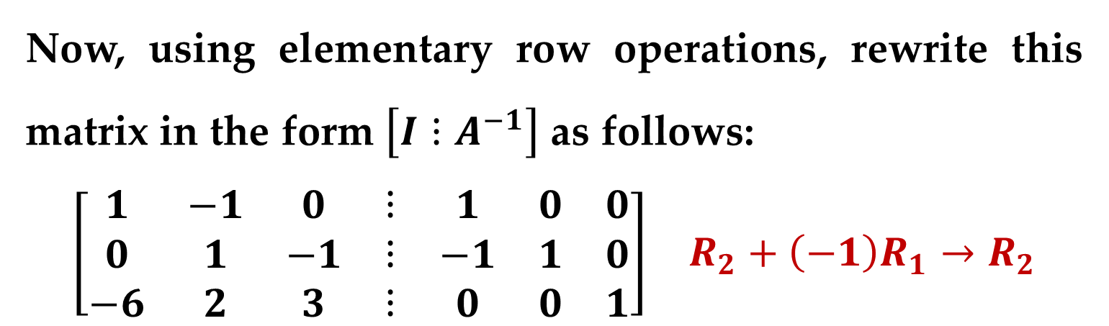
Solution (continued)
Now, using elementary row operations, rewrite this matrix in the form $\left[I⋮A^{−1}\right]$ as follows:
$$\begin{matrix}\left[\begin{matrix}\begin{matrix}1 & −1 & 0 \\ 0 & 1 & −1 \\ −6 & 2 & 3\end{matrix} & \begin{matrix}⋮ \\ ⋮ \\ ⋮\end{matrix} & \begin{matrix}1 & 0 & 0 \\ −1 & 1 & 0 \\ 0 & 0 & 1\end{matrix}\end{matrix}\right] & R_{2}+\left(−1\right)R_{1}→R_{2}\end{matrix}$$
$$\begin{matrix}\left[\begin{matrix}\begin{matrix}1 & −1 & 0 \\ 0 & 1 & −1 \\ 0 & −4 & 3\end{matrix} & \begin{matrix}⋮ \\ ⋮ \\ ⋮\end{matrix} & \begin{matrix}1 & 0 & 0 \\ −1 & 1 & 0 \\ 6 & 0 & 1\end{matrix}\end{matrix}\right] & R_{3}+\left(6\right)R_{1}→R_{3}\end{matrix}$$
The Inverse of a Matrix

Slide 21
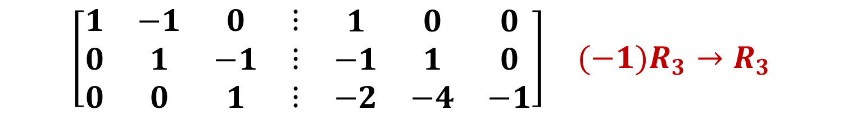

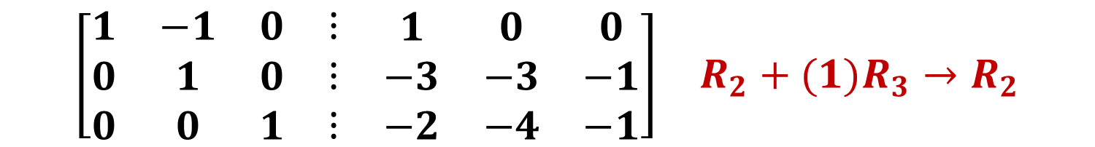
Solution (continued)
$$\begin{matrix}\left[\begin{matrix}\begin{matrix}1 & −1 & 0 \\ 0 & 1 & −1 \\ 0 & 0 & −1\end{matrix} & \begin{matrix}⋮ \\ ⋮ \\ ⋮\end{matrix} & \begin{matrix}1 & 0 & 0 \\ −1 & 1 & 0 \\ 2 & 4 & 1\end{matrix}\end{matrix}\right] & R_{3}+\left(4\right)R_{2}→R_{3}\end{matrix}$$
$$\begin{matrix}\left[\begin{matrix}\begin{matrix}1 & −1 & 0 \\ 0 & 1 & −1 \\ 0 & 0 & 1\end{matrix} & \begin{matrix}⋮ \\ ⋮ \\ ⋮\end{matrix} & \begin{matrix}1 & 0 & 0 \\ −1 & 1 & 0 \\ −2 & −4 & −1\end{matrix}\end{matrix}\right] & (−1)R_{3}→R_{3}\end{matrix}$$
$$\begin{matrix}\left[\begin{matrix}\begin{matrix}1 & −1 & 0 \\ 0 & 1 & 0 \\ 0 & 0 & 1\end{matrix} & \begin{matrix}⋮ \\ ⋮ \\ ⋮\end{matrix} & \begin{matrix}1 & 0 & 0 \\ −3 & −3 & −1 \\ −2 & −4 & −1\end{matrix}\end{matrix}\right] & R_{2}+(1)R_{3}→R_{2}\end{matrix}$$
The Inverse of a Matrix

Slide 22

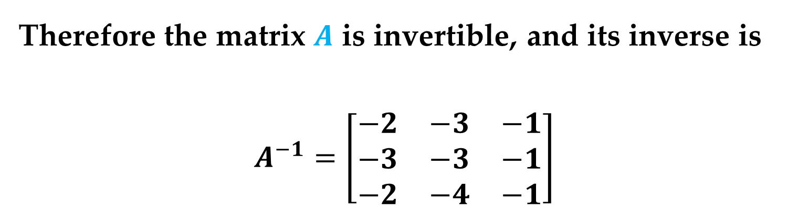
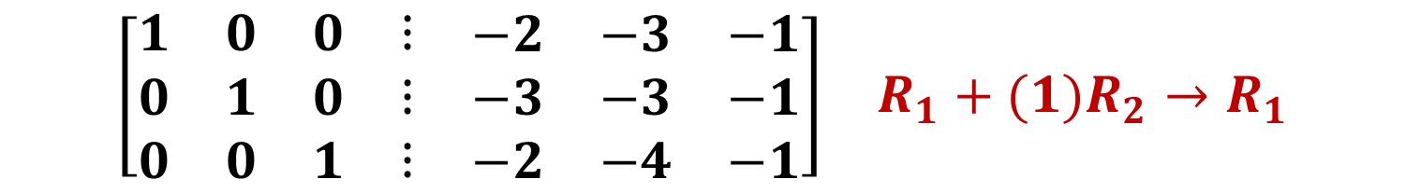
Solution (continued)
$$\begin{matrix}\left[\begin{matrix}\begin{matrix}1 & 0 & 0 \\ 0 & 1 & 0 \\ 0 & 0 & 1\end{matrix} & \begin{matrix}⋮ \\ ⋮ \\ ⋮\end{matrix} & \begin{matrix}−2 & −3 & −1 \\ −3 & −3 & −1 \\ −2 & −4 & −1\end{matrix}\end{matrix}\right] & R_{1}+(1)R_{2}→R_{1}\end{matrix}$$
Therefore the matrix $A$ is invertible, and its inverse is
$$A^{−1}=\left[\begin{matrix}−2 & −3 & −1 \\ −3 & −3 & −1 \\ −2 & −4 & −1\end{matrix}\right]$$
Task: Try confirming this by showing that
$$AA^{−1}=I=A^{−1}A$$
The Inverse of a Matrix

Slide 23
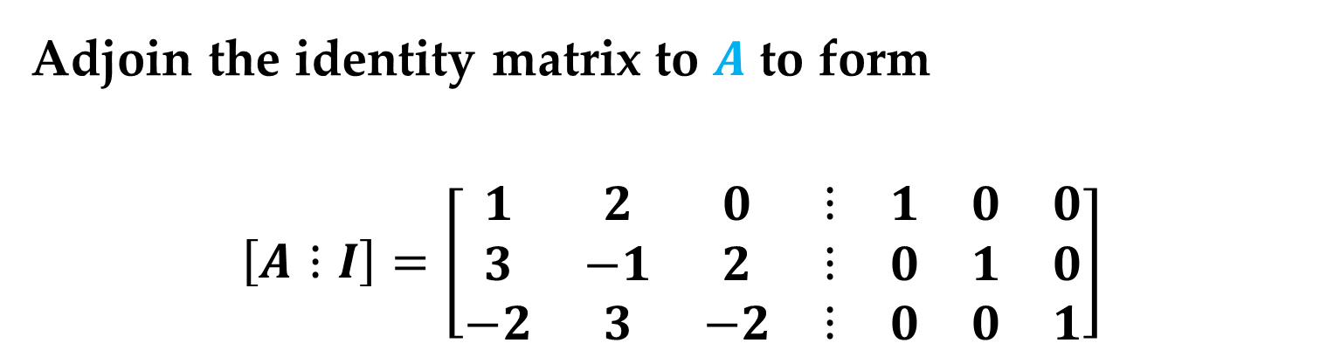

Example 4. A Singular Matrix
Show that the following matrix has no inverse
$$A=\left[\begin{matrix}1 & 2 & 0 \\ 3 & −1 & 2 \\ −2 & 3 & −2\end{matrix}\right]$$
Solution
Adjoin the identity matrix to $A$ to form
$$\left[A⋮I\right]=\left[\begin{matrix}\begin{matrix}1 & 2 & 0 \\ 3 & −1 & 2 \\ −2 & 3 & −2\end{matrix} & \begin{matrix}⋮ \\ ⋮ \\ ⋮\end{matrix} & \begin{matrix}1 & 0 & 0 \\ 0 & 1 & 0 \\ 0 & 0 & 1\end{matrix}\end{matrix}\right]$$
The Inverse of a Matrix

Slide 24

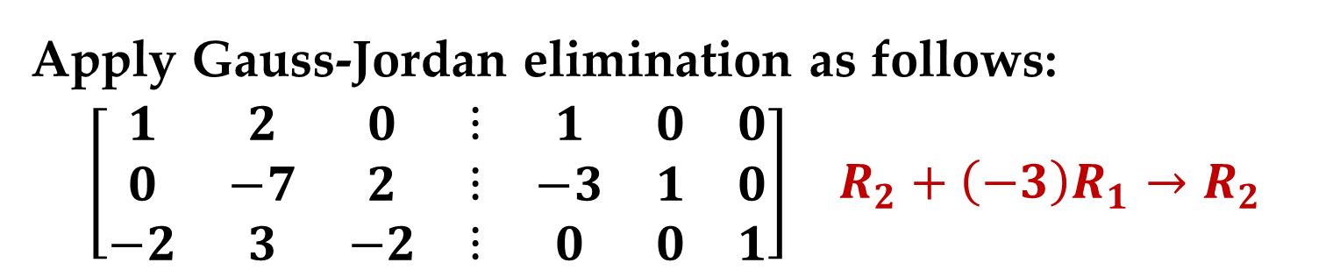
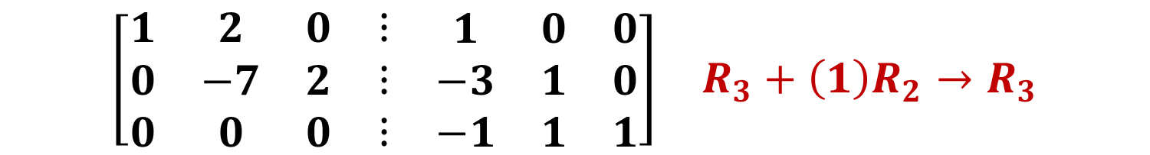
Solution (continued)
Apply Gauss-Jordan elimination as follows:
$$\begin{matrix}\left[\begin{matrix}\begin{matrix}1 & 2 & 0 \\ 0 & −7 & 2 \\ −2 & 3 & −2\end{matrix} & \begin{matrix}⋮ \\ ⋮ \\ ⋮\end{matrix} & \begin{matrix}1 & 0 & 0 \\ −3 & 1 & 0 \\ 0 & 0 & 1\end{matrix}\end{matrix}\right] & R_{2}+\left(−3\right)R_{1}→R_{2}\end{matrix}$$
$$\begin{matrix}\left[\begin{matrix}\begin{matrix}1 & 2 & 0 \\ 0 & −7 & 2 \\ 0 & 7 & −2\end{matrix} & \begin{matrix}⋮ \\ ⋮ \\ ⋮\end{matrix} & \begin{matrix}1 & 0 & 0 \\ −3 & 1 & 0 \\ 2 & 0 & 1\end{matrix}\end{matrix}\right] & R_{3}+\left(2\right)R_{1}→R_{3}\end{matrix}$$
$$\begin{matrix}\left[\begin{matrix}\begin{matrix}1 & 2 & 0 \\ 0 & −7 & 2 \\ 0 & 0 & 0\end{matrix} & \begin{matrix}⋮ \\ ⋮ \\ ⋮\end{matrix} & \begin{matrix}1 & 0 & 0 \\ −3 & 1 & 0 \\ −1 & 1 & 1\end{matrix}\end{matrix}\right] & R_{3}+\left(1\right)R_{2}→R_{3}\end{matrix}$$
The Inverse of a Matrix

Slide 25
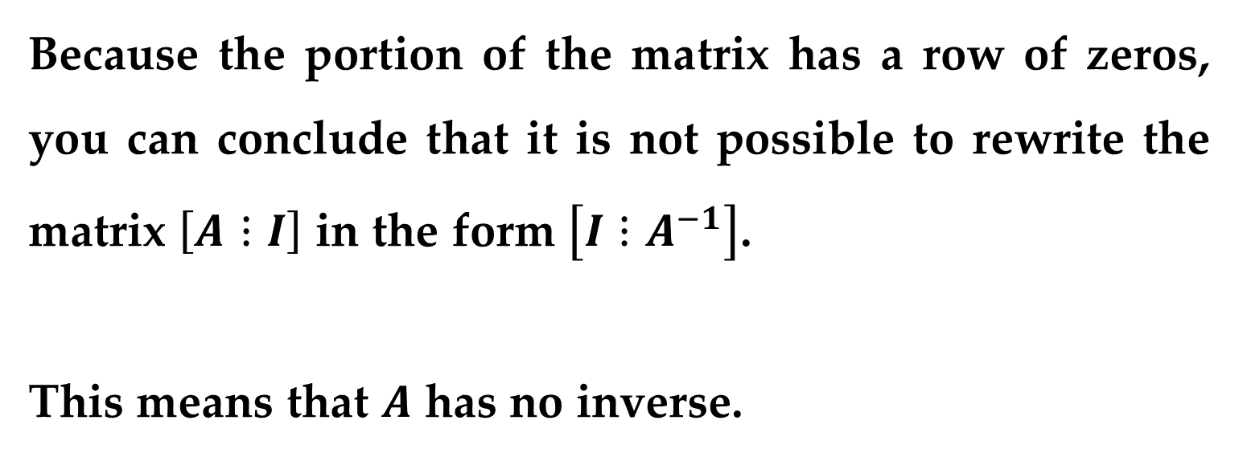
Solution (continued)
Now, notice that adding the second row to the third row produces a row of zeros on the left side of the matrix.
Because the portion of the matrix has a row of zeros, you can conclude that it is not possible to rewrite the matrix $\left[A⋮I\right]$ in the form $\left[I⋮A^{−1}\right]$.
This means that $A$ has no inverse.
The Inverse of a Matrix

Slide 26
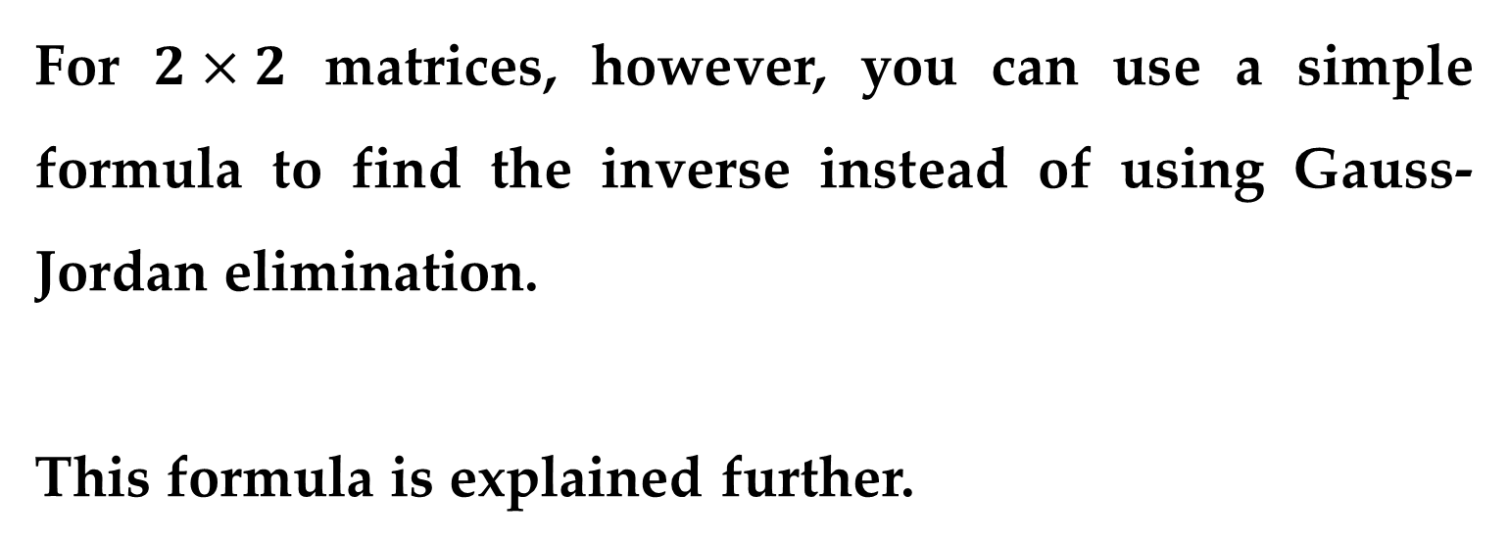
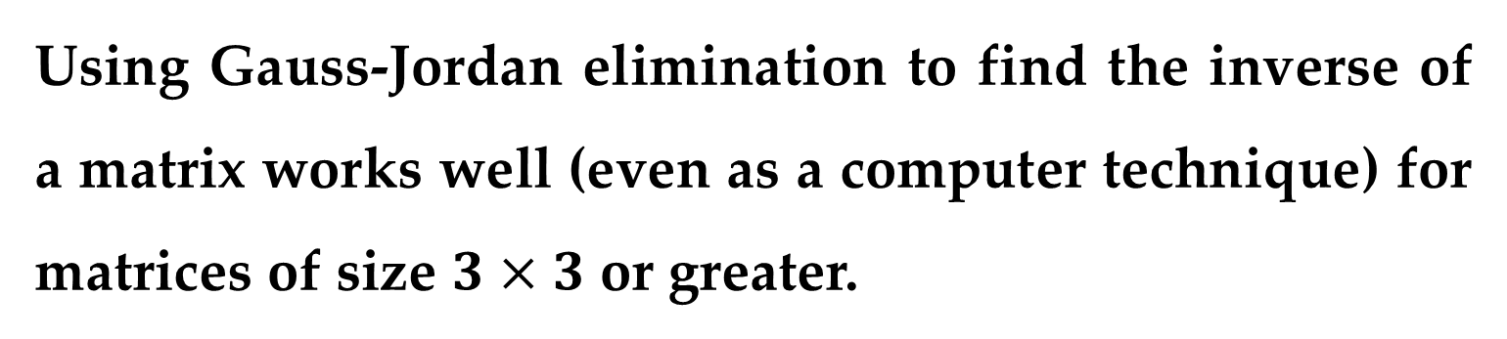
Using Gauss-Jordan elimination to find the inverse of a matrix works well (even as a computer technique) for matrices of size $3×3$ or greater.
For $2×2$ matrices, however, you can use a simple formula to find the inverse instead of using Gauss-Jordan elimination.
This formula is explained further.
The Inverse of a Matrix

Slide 27
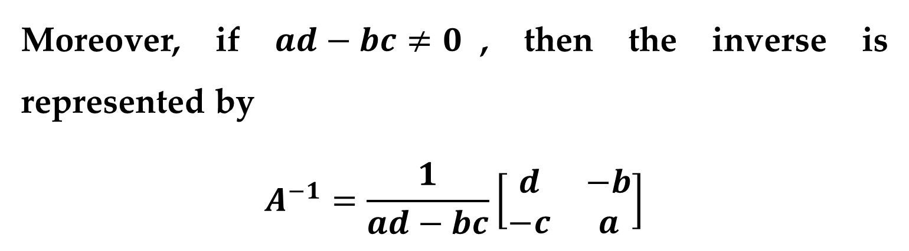
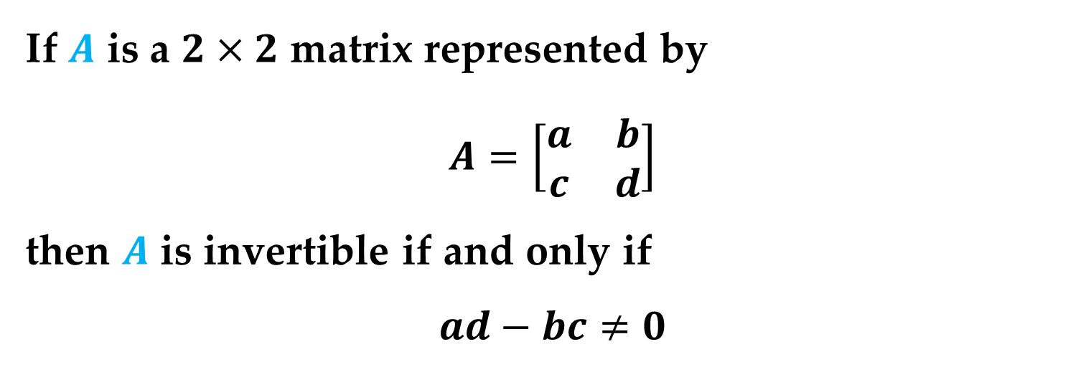
If $A$ is a $2×2$ matrix represented by
$$A=\left[\begin{matrix}a & b \\ c & d\end{matrix}\right]$$
then $A$ is invertible if and only if
$$ad−bc≠0$$
Moreover, if $ad−bc≠0$, then the inverse is represented by
$$A^{−1}=\frac{1}{ad−bc}\left[\begin{matrix}d & −b \\ −c & a\end{matrix}\right]$$
The Inverse of a Matrix

Slide 28

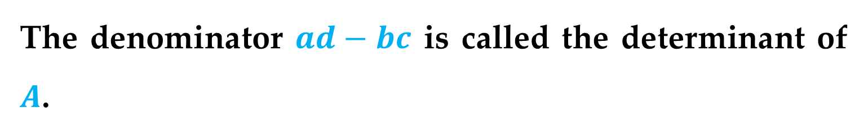
Task: Try verifying this inverse by finding the product
$$AA^{−1}$$
Remark
The denominator $ad−bc$ is called the determinant of $A$.
The Inverse of a Matrix

Slide 29
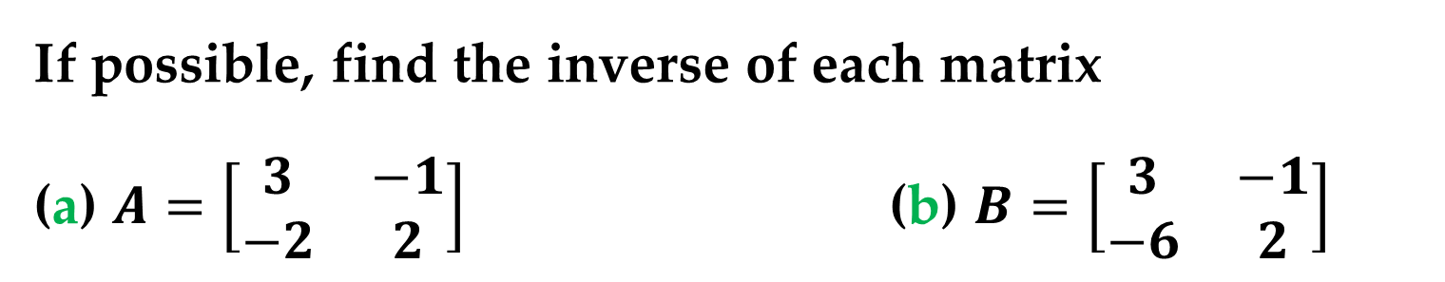
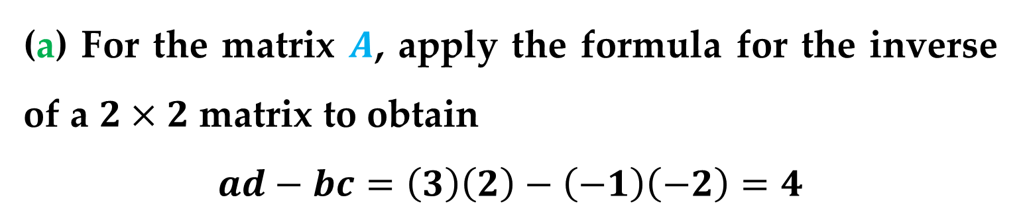
Example 5. Finding the Inverse of a 2 x 2 Matrix
If possible, find the inverse of each matrix
(a) $A=\left[\begin{matrix}3 & −1 \\ −2 & 2\end{matrix}\right]$ (b) $B=\left[\begin{matrix}3 & −1 \\ −6 & 2\end{matrix}\right]$
Solution
(a) For the matrix $A$, apply the formula for the inverse of a $2×2$ matrix to obtain
$$ad−bc=\left(3\right)\left(2\right)−\left(−1\right)\left(−2\right)=4$$
The Inverse of a Matrix

Slide 30
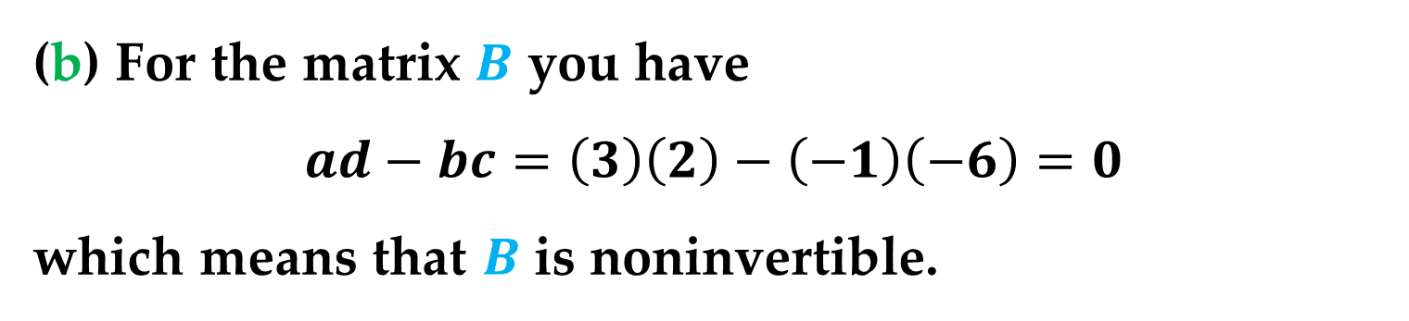
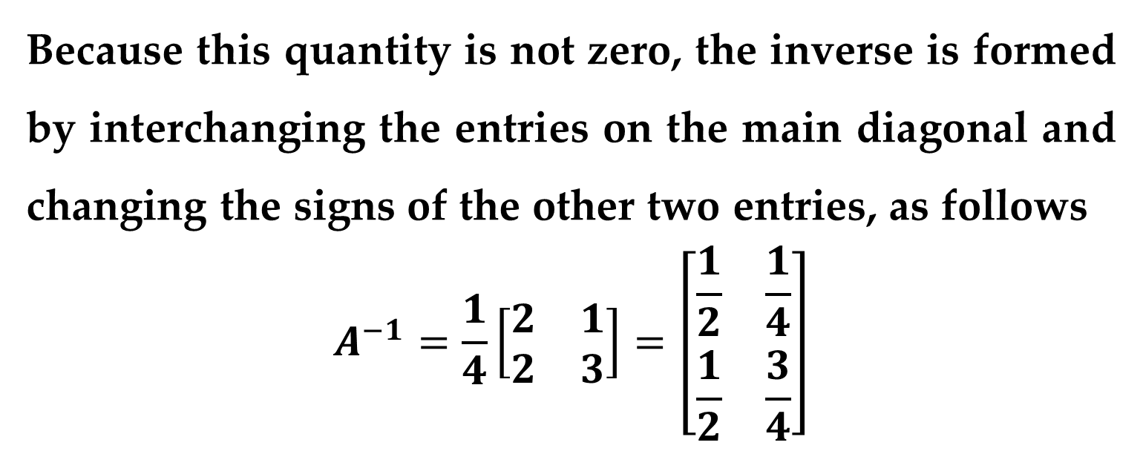
Solution (continued)
Because this quantity is not zero, the inverse is formed by interchanging the entries on the main diagonal and changing the signs of the other two entries, as follows
$$A^{−1}=\frac{1}{4}\left[\begin{matrix}2 & 1 \\ 2 & 3\end{matrix}\right]=\left[\begin{matrix}\frac{1}{2} & \frac{1}{4} \\ \frac{1}{2} & \frac{3}{4}\end{matrix}\right]$$
(b) For the matrix $B$ you have
$$ad−bc=\left(3\right)\left(2\right)−\left(−1\right)\left(−6\right)=0$$
which means that $B$ is noninvertible.
The Inverse of a Matrix

Slide 31
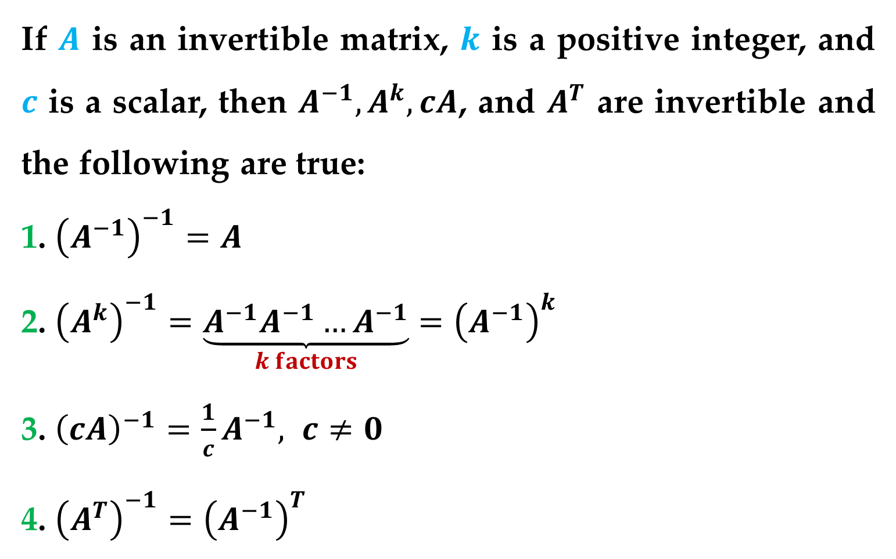
Theorem (Properties of Inverse Matrices)
If $A$ is an invertible matrix, $k$ is a positive integer, and $c$ is a scalar, then $A^{−1},A^{k},cA$, and $A^{T}$ are invertible and the following are true:
1. ${\left(A^{−1}\right)}^{−1}=A$
2. ${\left(A^{k}\right)}^{−1}=\underset{k factors}{\underbrace{A^{−1}A^{−1}…A^{−1}}}={\left(A^{−1}\right)}^{k}$
3. ${\left(cA\right)}^{−1}=\frac{1}{c}A^{−1}, c≠0$
4. ${\left(A^{T}\right)}^{−1}={\left(A^{−1}\right)}^{T}$
Properties of Inverses

Slide 32

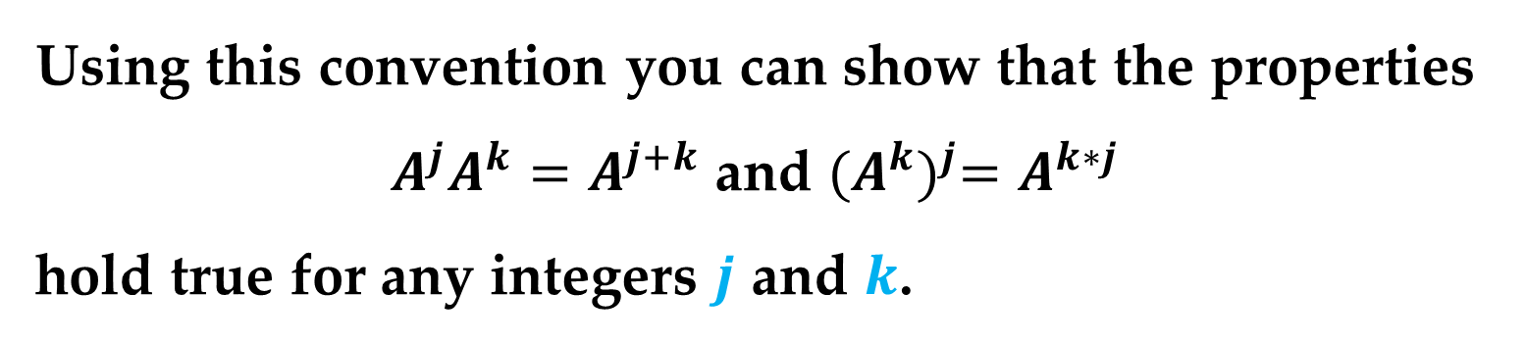
For nonsingular matrices, the exponential notation used for repeated multiplication of square matrices can be extended to include exponents that are negative integers.
This may be done by defining $A^{−k}$ to be:
$${\left(A^{−1}\right)}^{k}=\underset{k factors}{\underbrace{A^{−1}A^{−1}…A^{−1}}}=A^{−k}$$
Using this convention you can show that the properties $A^{j}A^{k}=A^{j+k}$ and ${(A^{k})}^{j}=A^{k∗j}$
hold true for any integers $j$ and $k$.
Properties of Inverses

Slide 33
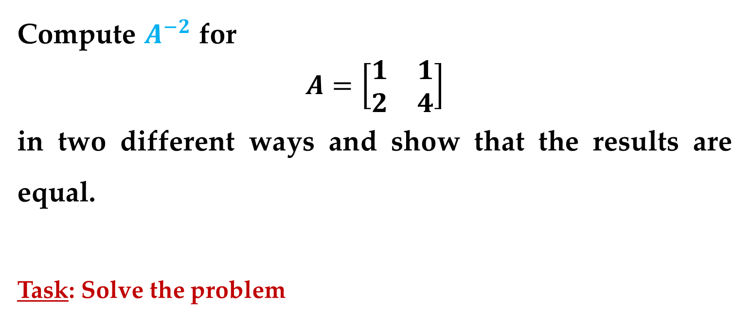
Example 6. The Inverse of the Square of a Matrix
Compute $A^{−2}$ for
$$A=\left[\begin{matrix}1 & 1 \\ 2 & 4\end{matrix}\right]$$
in two different ways and show that the results are equal.
Task: Solve the problem
Properties of Inverses

Slide 34
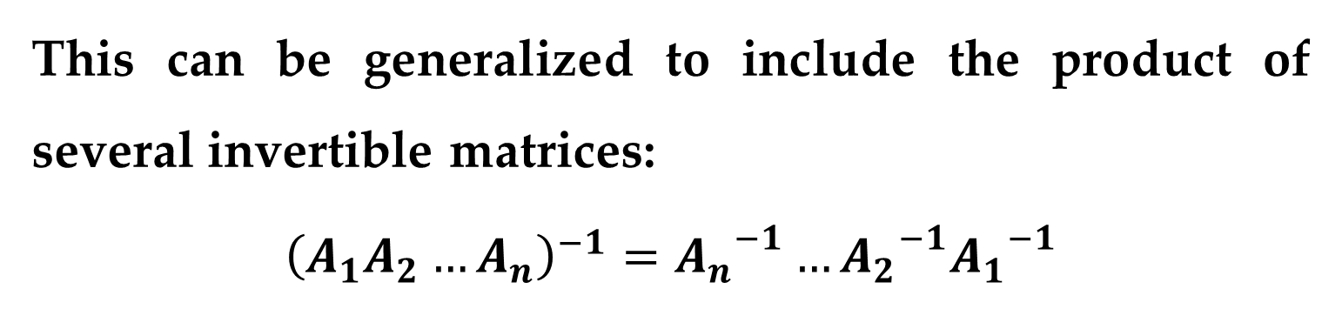
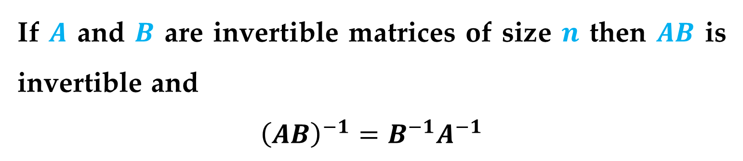
The next theorem gives a formula for computing the inverse of a product of two matrices.
Theorem (The Inverse of a Product)
If $A$ and $B$ are invertible matrices of size $n$ then $AB$ is invertible and
$${\left(AB\right)}^{−1}=B^{−1}A^{−1}$$
Remark
This can be generalized to include the product of several invertible matrices:
$${\left(A_{1}A_{2}…A_{n}\right)}^{−1}={A_{n}}_{}^{−1}…{A_{2}}_{}^{−1}{A_{1}}_{}^{−1}$$
Properties of Inverses

Slide 35
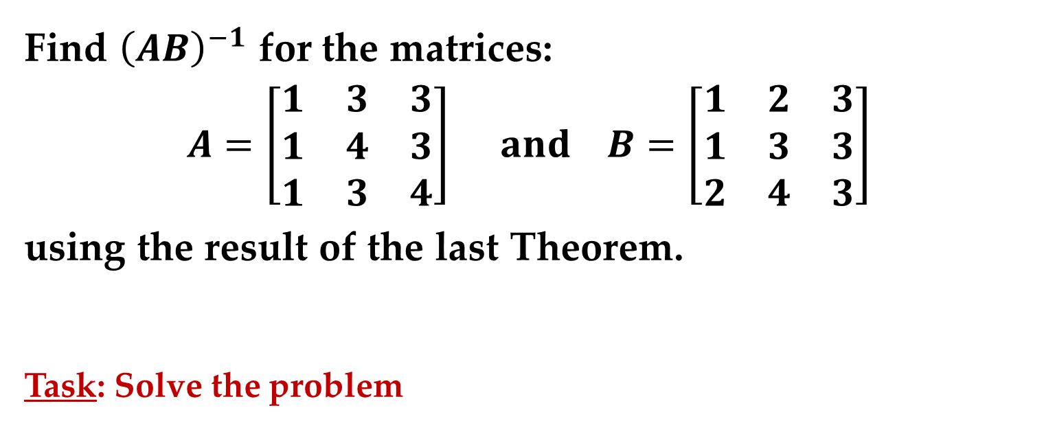
Example 7. Finding the Inverse of a Matrix Product
Find ${\left(AB\right)}^{−1}$ for the matrices:
$$A=\left[\begin{matrix}1 & 3 & 3 \\ 1 & 4 & 3 \\ 1 & 3 & 4\end{matrix}\right] and B=\left[\begin{matrix}1 & 2 & 3 \\ 1 & 3 & 3 \\ 2 & 4 & 3\end{matrix}\right]$$
using the result of the last Theorem.
Task: Solve the problem
Properties of Inverses

Slide 36

One important property in the algebra of real numbers is the cancellation property: that is, if $ac=bc (c≠0)$, then $a=b.$
Invertible matrices have similar cancellation properties.
Properties of Inverses

Slide 37


Theorem (Cancellation Properties)
If $C$ is an invertible matrix, then the following properties hold:
1. If $AC=BC$, then $A=B$ Right cancellation property
2. If $CA=CB$, then $A=B$ Left cancellation property
If $C$ is not invertible, then cancellation is not usually valid.
Properties of Inverses

Slide 38

For square systems, you can use the theorem below to determine whether the system has a unique solution.
Theorem (Systems of Equations with Unique Solutions)
If $A$ is an invertible matrix, then the system of linear equations $Ax=b$ has a unique solution given by
$$x=A^{−1}b$$
Systems of Equations

Slide 39

Remark
This solution is unique because if $x_{1}$ and $x_{2}$ were two solutions, you could apply the cancellation property to the equation $Ax_{1}=b=Ax_{2}$ to conclude that $x_{1}=x_{2}$.
Remark
The last theorem is theoretically important, but it is not very practical for solving a system of linear equations.
Systems of Equations

Slide 40


It would require more work to find $A^{−1}$ and then multiply by $b$ than simply to solve the system using Gaussian elimination with back-substitution.
A situation in which you might consider using the last theorem as a computational technique would be one in which you have several systems of linear equations, all of which have the same coefficient matrix.
In such a case, you could find the inverse matrix once and then solve each system by computing the product $A^{−1}b$.
Systems of Equations

Slide 41

Example 8. Solving a System of Equations Using an Inverse Matrix
Use an inverse matrix to solve each system
(a) $\begin{matrix}2x+3y+z=−1 \\ 3x+3y+z=1 \\ 2x+4y+z=−2\end{matrix}$ (b) $\begin{matrix}2x+3y+z=4 \\ 3x+3y+z=8 \\ 2x+4y+z=5\end{matrix}$
(c) $\begin{matrix}2x+3y+z=0 \\ 3x+3y+z=0 \\ 2x+4y+z=0\end{matrix}$
Systems of Equations

Slide 42


Solution
First note that the coefficient matrix for each system is
$$A=\left[\begin{matrix}2 & 3 & 1 \\ 3 & 3 & 1 \\ 2 & 4 & 1\end{matrix}\right]$$
Using Gauss-Jordan elimination, you can find $A^{−1}$ to be
$$A^{−1}=\left[\begin{matrix}−1 & 1 & 0 \\ −1 & 0 & 1 \\ 6 & −2 & −3\end{matrix}\right]$$
Systems of Equations

Slide 43

Solution (continued)
To solve each system, use matrix multiplication as follows
(a) $x=A^{−1}b=\left[\begin{matrix}−1 & 1 & 0 \\ −1 & 0 & 1 \\ 6 & −2 & −3\end{matrix}\right]\left[\begin{matrix}−1 \\ 1 \\ −2\end{matrix}\right]=\left[\begin{matrix}2 \\ −1 \\ −2\end{matrix}\right]$
(b) $x=A^{−1}b=\left[\begin{matrix}−1 & 1 & 0 \\ −1 & 0 & 1 \\ 6 & −2 & −3\end{matrix}\right]\left[\begin{matrix}4 \\ 8 \\ 5\end{matrix}\right]=\left[\begin{matrix}4 \\ 1 \\ −7\end{matrix}\right]$
(c) $x=A^{−1}b=\left[\begin{matrix}−1 & 1 & 0 \\ −1 & 0 & 1 \\ 6 & −2 & −3\end{matrix}\right]\left[\begin{matrix}0 \\ 0 \\ 0\end{matrix}\right]=\left[\begin{matrix}0 \\ 0 \\ 0\end{matrix}\right]$
Systems of Equations

Slide 44
Thank You for Attention

